Slide 1
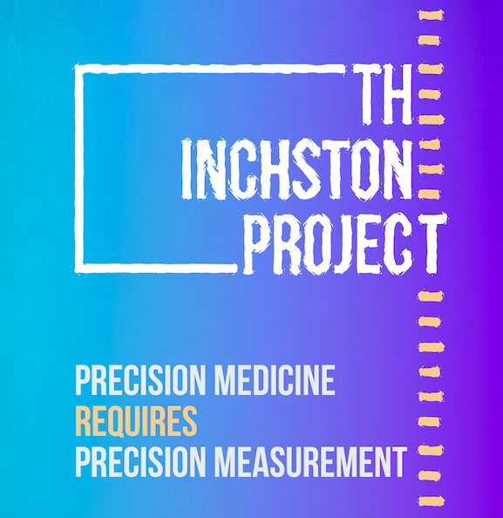
Cognition and Behavior in Children and Young Adults with SCN2A-Developmental and Epileptic Encephalopathy (DEE): An Initial Evaluation of the Developmental Profile, Fourth Edition (DP-4)
Natasha N. Ludwig¹, Mary Wojnaroskii², Ariela Kaiser³, Katherine Paltell³, Lindsey Evans⁴, Jenny Downs⁵, Chere AT Chapman⁶, Gabrielle Conecker⁷, JayEtta Hecker⁷, Keith Coffman⁸, Leah Schust Myers⁹, Terry Jo Bichell¹⁰, Anne T. Berg¹¹
¹Kennedy Krieger Institute/Johns Hopkins School of Medicine, Department of Neuropsychology/Psychiatry & Behavioral Sciences, Baltimore, MD, USA, ²Nationwide Children’s Hospital/Ohio State University, Department of Psychology/Psychiatry and Behavioral Health, Columbus, OH, USA, ³University of Illinois at Chicago, Chicago, IL, ⁴Illinois Institute of Technology, Department of Psychology, Chicago, IL, ⁵Telethon Kids Institute, Centre for Child Health Research, The University of Western Australia, Perth, Australia, ⁶Ardea Outcomes, Halifax, Nova Scotia, Canada, ⁷DEE-P Connections/Decoding Developmental Epilepsies, ⁸Children’s Mercy, Kansas City, MO, USA, ⁹FamilieSCN2A Foundation, E. Longmeadow, MA, USA, ¹⁰Combined Brain, ¹¹Northwestern Feinberg School of Medicine, Dept. Neurology, Chicago, IL, USA
Rationale
Results
Conclusions
SCN2A-associated developmental and epileptic encephalopathy (DEE) is associated with profound impact to development.
Commonly used clinical outcome measures for these domains have substantial floor effects and are thus not fit for purpose for clinical trials.
Recent FDA guidances emphasize the need for appropriate measures, especially in trials for rare diseases.
This study seeks to explore the initial suitability of the Developmental Profile, Fourth Edition (DP-4) Parent/Caregiver Checklist, a new, easy to administer caregiver questionnaire, in capturing a range of neurodevelopmental outcomes in children with SCN2A-DEE.
Table 1. Mean, standard deviation, range, and percent of lowest possible Standard Scores and age-equivalents on the DP-4, Bayley-4, and Vineland-3
The DP-4 is a parent questionnaire-based measure of child neurodevelopmental skills that requires relatively fewer resources than direct in-person assessments like the Bayley-4 and extensive parent interviews like the Vineland-3.
While standardized scores were limited given that a high number of participants earned the lowest possible scores, AEs and raw scores provided more range and variability.
Given similar frequency of floor effects and high correlations with the Bayley-4 and Vineland-3, the DP-4 may provide a quick and accessible way to capture non-seizure outcomes in children and young adults with SCN2A-DEE.
Future work via The Inchstone Project will explore the validity and utility of the DP-4 in larger samples and in other DEEs characterized by severe impairment to inform use in clinical and research contexts.
DP-4 Scale | M SS (SD; range) | N Lowest possible* | M AE months (SD; range) | N Lowest possible* | M Raw (SD; range) | N Lowest possible*
Cognition | 41.3 (3.0; 40-49) | 8 | 13.8 (9.9; 0.5-29.5) | 2 | 8.7 (5.5; 2-17) | 0
Communication | 41.6 (5.1; 40-56) | 9 | 9.2 (8.2; 0.5-22.5) | 3 | 7.0 (6.0; 0-17) | 1
Physical | 40.9 (2.9; 40-49) | 9 | 13.4 (8.4; 0.5-25.5) | 1 | 10.6 (7.4; 0-21) | 1
Social-Emotional | 43.9 (9.6; 40-70) | 8 | 6.2 (10.0; 0.5-29.5) | 7 | 6.0 (4.5; 2-16) | 0
Adaptive Behavior | 41.40 (3.8; 40-52) | 8 | 14.7 (12.0; 0.5 -38.5) | 2 | 9.5 (7.1; 0-22) | 1
Bayley-4 Scale | M SS (SD; range) | N Lowest possible* | M AE months (SD; range) | N Lowest possible* | M Raw (SD; range) | N Lowest possible*
Cognition | - | - | 10 (9.5; 0.7-27.0) | 0 | 51.0 (3.0-116.0) | 0
Vineland-3 Subdomain | M V-Scale (SD; range) | N Lowest possible* | M AE months (SD; range) | N Lowest possible* | M Raw (SD; range) | N Lowest possible*
Receptive | 1.60 (1.3;1-5) | 8 | 11.2 (7.6; 0-27) | 1 | 21.2 (17.4; 2-54) | 0
Expressive | 1.0 (0; 1-1) | 10 | 9.7 (8.3; 0-23) | 2 | 16.6 (14.4; 1-43) | 0
Written | 4.4 (3.9; 1-13) | 4 | 38.6 (8.0; 34-54) | 7 | 4.8 (6.9; 0-17) | 4
Personal | 1.60 (1.4; 1-5) | 8 | 12.0 (12.0; 0-31) | 3 | 16.1 (17.3; 0-45) | 3
Domestic | 4.80 (2.0; 1-8) | 1 | 35.0 (0; 35-35) | 10 | 0.6 (1.9; 0-6) | 9
Community | 3.4 (2.5; 1-7) | 4 | 35.2 (0.63; 35-37) | 9 | 2.0 (3.8; 0-12) | 6
Interpersonal Relationships | 3.0 (2.3; 1-7) | 4 | 7.8 (8.3; 1-29) | 0 | 20.3 (11.9; 9-48) | 0
Play and Leisure | 2.90 (2.1;1-6) | 5 | 5.5 (4.2; 0-12) | 1 | 6.8 (3.9; 2-14) | 0
Coping Skills | 6.1 (3.1; 1-10) | 2 | 23.0 (0;23-23) | 10 | 10.0 (4.5; 4-19) | 0
Fine Motor | 3.0 (2.9; 1-8) | 5 | 11.4 (9.6; 0-26) | 1 | 13.7 (12.1; 0-30) | 1
Gross Motor | 3.0 (3.9; 1-10) | 5 | 14.9 (10.5; 3-30) | 0 | 33 (27.0; 2-66) | 0
Methods
The Inchstone Project
A collaboration of patient advocates, researchers, clinicians and industry partners with an aim to develop outcome measures for children with severe DEEs.
Data was collected during a recent pilot study at SCN2A family conference, July 2022.
Participants
10 children with pathogenic variants in SCN2A
M_{age}=8.2 years, SD=5.62, range 3.4-20.4; N_{male}=8
Measures
Developmental Profile, Fourth Edition (DP-4): Electronically administered standardized caregiver questionnaire. Measures 5 domains of development including: Cognitive, Communication, Physical, Social-Emotional, and Adaptive Behavior.
Bayley Scales of Infant and Toddler Development (Bayley-IV), Cognitive scale: Standardized direct child assessment of cognition.
Vineland Adaptive Behavior Scales, Parent/Caregiver Interview (Vineland-3): Standardized parent interview of child adaptive functioning.
Note. AE=Age-equivalent; M=Mean; SD=Standard Deviation; SS= Standard Score; V-Scale=Vineland-3 scale scores (M=15 SD=3). Bayley-4 Cognition SSs are not provided given that 90% of children were out of the intended age-range for the measure and norm-referenced scores were not available. Vineland-3 Motor Skills subdomain V-scales scores are also not provided given that a small N were within the intended age-range for the scale (birth-9) and norm-referenced scores were not available.
*Lowest possible scores: DP-4 SS=40 and AE=0.5 months; Bayley-4 AE=0 months; Vineland-3 V-scale=1, AE for Receptive, Expressive, Gross Motor, Fine Motor, Interpersonal Relationships, Play and Leisure, and Personal subdomains=0 months and other scales range from 23-35 months.
Table 2. Pearson Correlations between the DP-4 and Bayley-4 and Vineland-3 AEs
Bayley-4 Scale | DP-4 Scale | r | p-value
Cognition | Cognition | .80 | .05
Vineland-3 Subdomain | DP-4 Scale | r | p-value
Receptive | Communication | .69 | .03
Expressive | Communication | .77 | .009
Personal | Adaptive Behavior | .92 | .001
Interpersonal Relationships | Social-Emotional | .71 | 0.23
Play and Leisure | Social-Emotional | .60 | .07
Fine Motor | Physical | .97 | <.001
Gross Motor | Physical | .93 | <.001
We thank the children and families who participated in this study and the FamilieSCN2A Foundation for their support in this work.
Funding source: The Inchstone Project, a project of DEE-P Connections"
Note. Correlations not computed for Vineland-3 Written, Domestic, Community, and Coping Skills domains due to high rates of lowest possible AEs on these domains.

