Slide 2
Complex Care Systems
Amelia Auberger
Scott Callahan
Abby Musial

Slide 3
Disclosures
We have no relevant financial relationships with the manufacturer(s) of any commercial product(s) and/or provider(s) of commercial services discussed in this CME activity.​
​
Permission has been obtained to share patient photos.

Slide 4
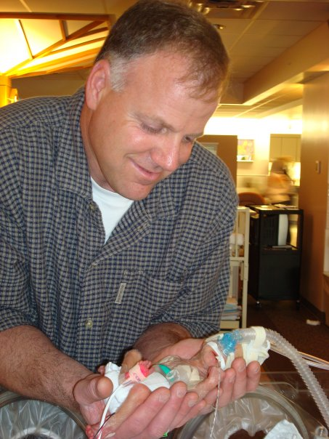
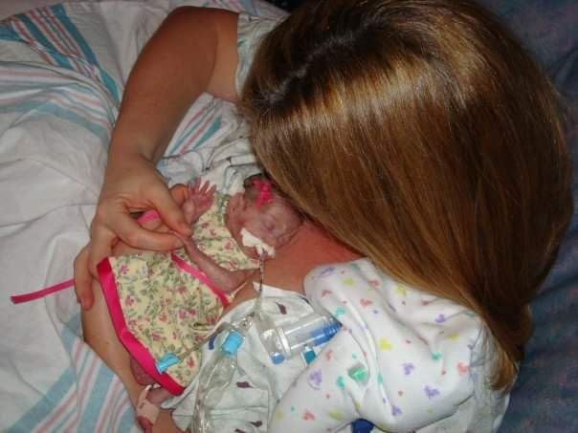
Addie’s Story…
Born at 23 weeks
1lb 7oz, 11 inches long
119 days in a local NICU

Slide 5
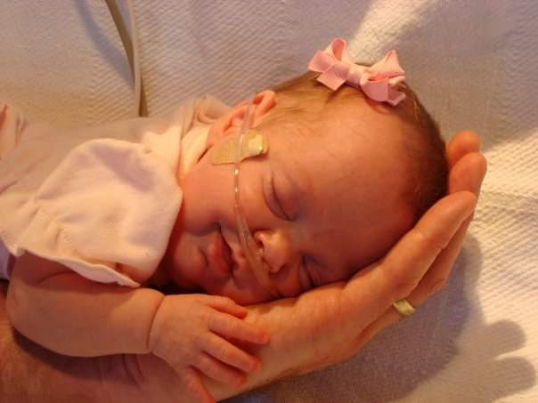
Discharged on oxygen
Hospitalized for FTT and later received a GT due to inability to sustain nutrition
Initially followed by a local pediatrician, 9 Specialists, OT, PT and SLP
Averaged 16 appointments monthly for first 3 years of life
Non-ambulatory, Nonverbal, Uses Communication Device

Slide 6
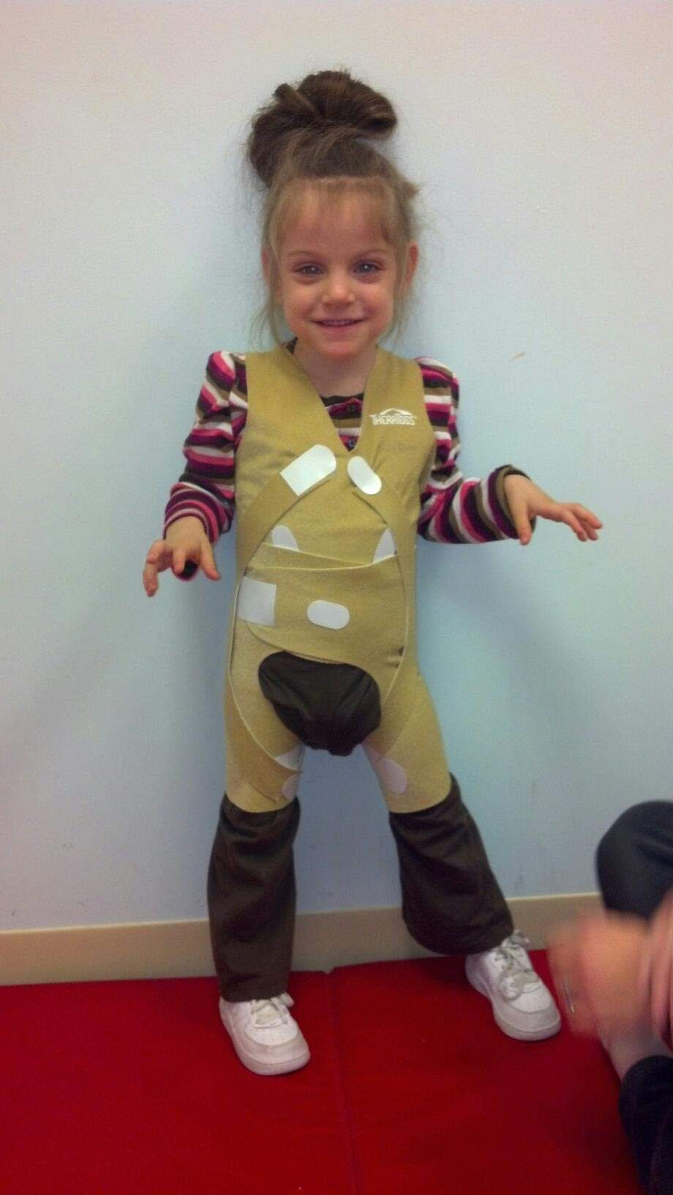
My Complex Care Journey…
Social Worker in CC for past 5 years
Soon realized that this was a benefit Addie was missing
Spoke with Addie’s community pediatrician and we both agreed that Addie would be better served in CC
Referral made
Onboarding discussions took place
Addie became a patient at CC 2 years ago

Slide 7
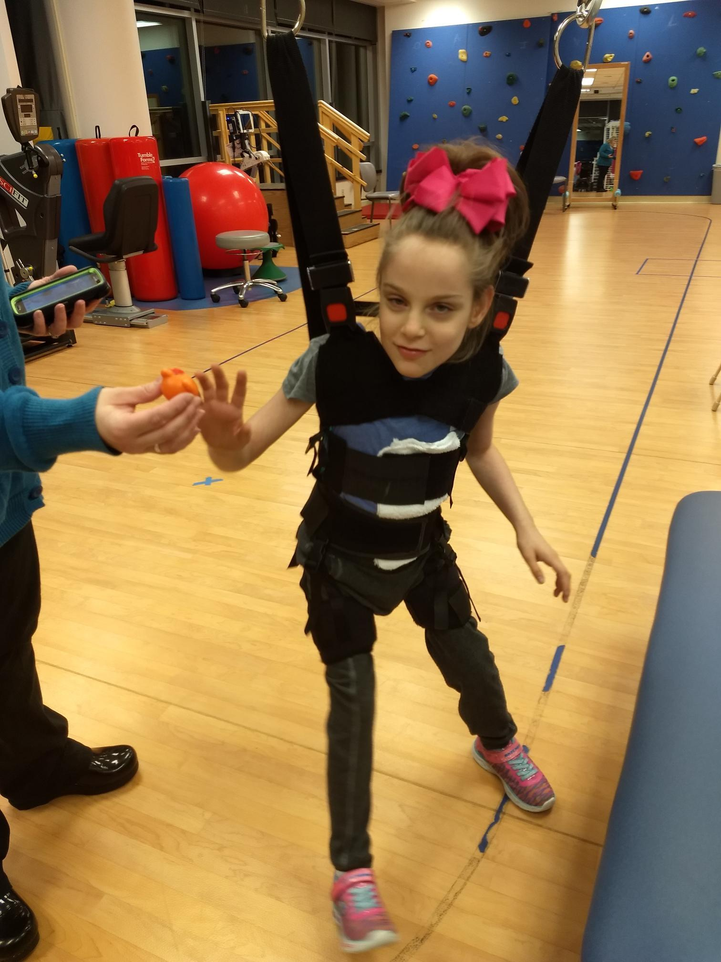
Some Benefits of Complex Care…
Expertise of rare conditions and disorders
Confidence with equipment
Knowing when to make referrals (communication devices, etc.)
Collaboration with care team (care conferences)
Collaboration with schools and other outside resources
Access to multidisciplinary team that is familiar with the complex population (RD, Pharmacist)

Slide 8
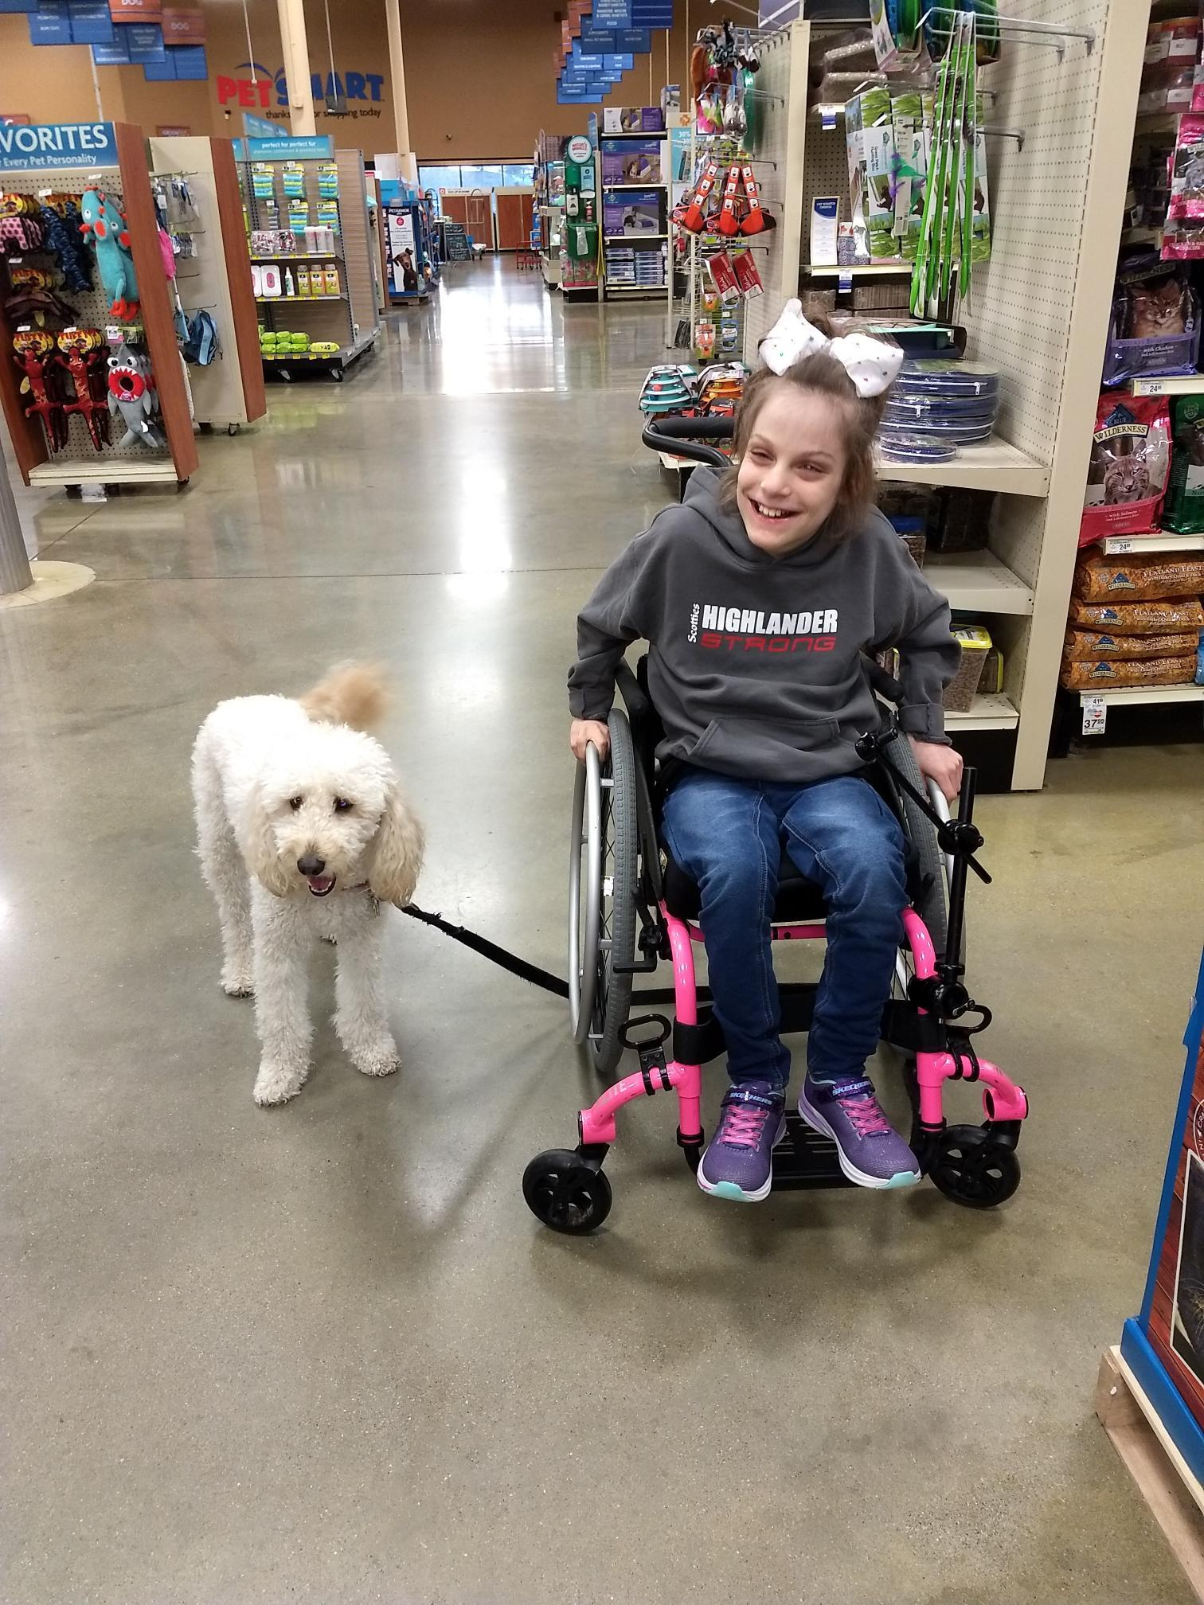
Some Benefits of Complex Care (cont’d)
Quick turnaround with parent questions
Community referrals
Encouragement for extra curricular activities
Amount of time spent in appointments
Ability to bring specialists into appointments
Tyto Care & Telehealth Appointments
Support with transition

Slide 9
Cincinnati Children’s Hospital Medical Center Complex Care Outpatient Center
Functions as the primary care medical home for 611 children and young adults with complex chronic medical conditions.
The Center has provided consultative and/or ongoing co-management visits for an additional 23 patients from 3 states who receive primary care at a distance.

Slide 10
Who is the CCHMC Complex Care Patient
Multi-system complexity from prematurity, genetic, congenital and acquired diseases.
Technology Dependent (e.g. Trach or surgically placed G-Tube), and/or large subspecialty use/hospice

Slide 11
Who is the CCHMC Complex Care Patient
Sees an average of 8 sub-specialties
Averages 4 visits per year in CCC clinic
Averages close to 2 admissions per patient, 9 bed days in a two-year period
Nationally these patients account for one-third of all child health expenditures, use approximately one-fourth of all hospital days¹
Produces 28 forms per year on average to be signed by the provider including Home Care orders which require a review every 60 days; Total forms for the CCC exceed 13,000²

Slide 12
Current Complex Care Provider Staffing
Provider | Current
 | FTE | cFTE
Medical Director | 1.00 | 0.50
NP | 2.00 | 1.40
Faculty | 1.4 | 0.98
Faculty (Med Peds) | 0.00 | 0.00
Fellow | 0.00 | 0.00
Staff Physician | 1.0 | 0.64
Total | 5.4 | 3.52
 | Current
 | FTE
Clinical Manager | .8
Clinic RN | 6.0
Medical Assistant | 1.0
RN Triage Day | 1.0
Dietician | 1.5
Pharmacist | 1.0
RN (CM) | 5.0
Social Workers (CM) | 3.0
Social Workers | 1.0
Total | 20.3

Slide 13
Appointments
01/01/2022-12/31/2022
Total visits: 2,948
In person: 2,530
Telehealth: 418

Slide 14
Cincinnati Children’s Hospital Medical Center Inpatient Complex Care Team – “Yellow Team”
Founded 10 years ago
Housed under Hospital Medicine
Cap at 10 patients
Admission criteria include
Presence of medical technology and need for coordination of multiple subspecialities
Hospice/Starshine patient
Complex Care Outpatient Center patient

Slide 15
Yellow Team Staff
Social Worker
2 Care Managers
Dietitian
Pharmacist
10 APPs
Small, core group of hospitalists
Hospital medicine fellow
Residents

Slide 16
Scheduled Rounds
Rounds are scheduled each day by the senior resident
Assists in improving nursing presence for rounds
Gives families a time frame for rounds so they are not waiting for several hours

Slide 17
Collaboration with other Sub-specialists
Co-round with subspecialties
Organize care conferences
Ensure adequate follow up

Slide 18
Care Coordination Rounds
Daily multidisciplinary huddle with care manager​
The team reviews each patient’s discharge goals, outlining tasks to be completed prior to discharge​
Discharge goals are listed and updated in the electronic health record​
A needs assessment tool serves as the framework for the conversation and needs document in a care manger progress note​

Slide 19
Pre- and Post Discharge Huddles
Teleheath visits with caregivers, inpatient providers, and outpatient providers
Summary of hospitalization given
Transition pieces such as pending labs, important follow up appointments, return precautions discussed
Allows opportunity for questions and concerns to be addressed

Slide 20
How to find a Complex Care Center near you
Ask a specialist!
Ask me (abigail.musial@cchmc.org)
List accessible through D-EEP Connections website

Slide 23
Program for Children with Medically Complex Needs
Katherine Freundlich, MD, FAAP

Slide 24
A Tiny Bit About Me
MD from Baylor College of Medicine
Graduated from Pediatric Residency at the University of Michigan
Initial pediatrics role in hospital and outpatient clinics
Found a fit in the growing complex care program at Vanderbilt in 2016
Now serve as the Director of Family, Community, and Referring Network Engagement for our program

Slide 25
About Our Program
Family-centered
Goal to empower, mutually educate, share decision-making with families
Family Clinical Advisory Group set up for guidance
Continuity
Care across inpatient, outpatient and between-visit settings
Streamlined
Collaborative
Bring key team members together
Supplementary
“Consultant” model designed to partner with primary care offices

Slide 26
About Our Program
Some of our families have summarized us as the “Get Stuff Done” team

Slide 27
About Our Team (current as of 6/7/23)
Family Clinical Advisory Group
3 physicians
2 nurse practitioners
4 registered nurses
1 dietitian
1 scheduler
1 (shared) pharmacist
1 (shared) social worker
1 (shared) inpatient case manager

Slide 28
Enrollment Criteria
Check website for the latest information if viewing a recording!
A lifelong chronic illness that is not expected to go away
One hospital admission of 10 days or more, or one ICU admission, or two hospital admissions in the past year
At least four subspecialty groups significantly involved
No other team dedicated to the care of the child’s particular illness (i.e. cystic fibrosis or sickle cell disease program)
Age under 15 years at enrollment

Slide 29
Thank you!! Questions welcome
Program telephone: 615-875-0901

